Slide 1
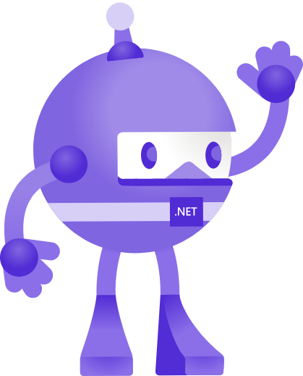

Umbraco
+ MAUI
Carl Sargunar
@carlcod_es
+

Slide 2
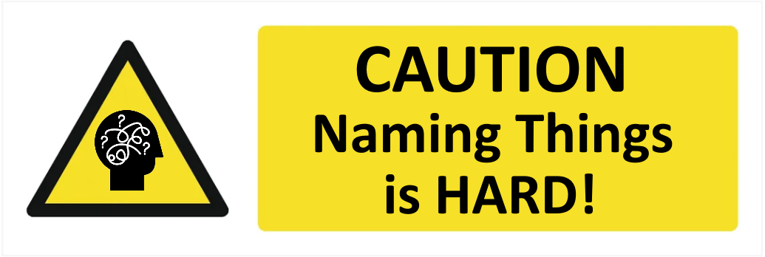
What is .NET MAUI?
Carl Sargunar
Multi-platform
Application
User Interface
@carlcod_es
Notes:
Why is Maui like a Pneumatic Pteradactyl?
The P is silent
Naming things is hard

Slide 3
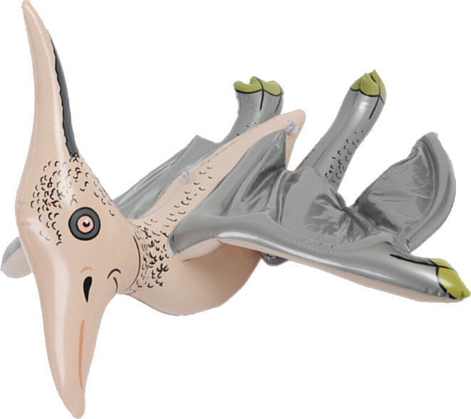
What is .NET MAUI?
Carl Sargunar
Q: Why is .NET MAUI like a Pneumatic Pterodactyl?
A: Because the P is Silent 🥁😂🤐
Multi-platform
Application
User Interface
@carlcod_es
Notes:
Why is Maui like a Pneumatic Pteradactyl?
The P is silent
Naming things is hard

Slide 4
What is .NET MAUI?
Carl Sargunar
.NET
Evolution of Xamarin.Forms
Unified framework for Android, iOS, macOS, and Windows (and Tizen)
Native controls, performance, and SINGLE PROJECT structure
UI built with XAML
Maui Blazor - alternative UI Framework
UI can also be built entirely in C#
MAUI is NOT the best option for Windows-Only, Desktop-Only Applications
.NET Multi-platform App UI
iOS
macOS
Android
Windows
@carlcod_es
Notes:
Historically Xamarin Forms (single UI), alongside Xamarin.iOs and Xamarin.Android for custom UI.
Originally designed for data entry and capture - forms apps, mostly used by internal apps. Now a lot more powerful
Not using Maui Blazor in this talk as it’s not the predominant way of building Maui Apps. Performance overhead of running an app inside a browser inside an app
WinUI, WPF, UWP - all options for windows desktop

Slide 5


MAUI Architecture
Carl Sargunar
Application Code
Android
iOS
macOS
Windows
@carlcod_es

Slide 6
MAUI Architecture
Carl Sargunar
Application Code
.NET MAUI
.NET Android
.NET for iOS
.NET for Mac
WinUI 3
.NET BCL
Mono Runtime
.NET CLR
Android
iOS
macOS
Windows
@carlcod_es
Notes:
App code talks to .NET Maui
As it’s a .NET app, it needs a .NET Runtime. Mono (OSS version of the .NET runtime) and traditional .NET CLR
Then BCL = Base Class Libraries (.NET 6 +, now 7), which depends on the runtime
Platform specific UI framework
App code can also directly talk to the platform specific framework

Slide 7
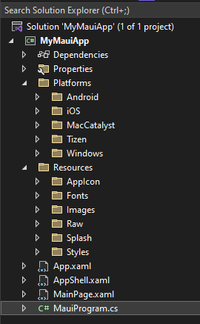
Anatomy of a MAUI App
Carl Sargunar
Platforms : Platform specific code, resources, configuration and startup logic
MauiProgram.cs : “App” bootstrapper, Set up Dependencies, Register services. Called by platform code
Resources : Fonts, Icons, Translations and assets - shared across all platforms
App.Xaml and App.Xaml.cs : Sets up the resources in the app. Defines the main App class. Creates initial window.
AppShell.Xaml : Defines the Navigation and page structure, and loads the first Page
MainPage.xaml : The first page of the application
@carlcod_es
Notes:
MauiProgram called by the platform code. Similar to the Program.cs

Slide 8
Pages
Carl Sargunar
Single Screen of Content
Each Page will hold a single item
Use Layouts for multiple child controls
Stack Layout
Grid Layout
Flex Layout
Absolute Layout
ContentPage
ContentPage
Control
Layout
Control
Control
Control
@carlcod_es
Notes:
In a Content Page, you can ONLY have ONE control
Layout control allows you to have nested control
Layouts can be themselves nested under other layouts

Slide 9
Pages Layout
Carl Sargunar
Use Layouts to handle multiple child controls
Stack Layout
Vertical or Horizontal
Grid Layout
Flex Layout
Stack Layout
Absolute Layout
Grid Layout
Also Bindable Layout
Flex Layout
Absolute Layout
@carlcod_es
Notes:
Stack Layout : Size is not explicitly set, expands to fill available width (or height if using horizontal stack layout)
Grid Layout : Elements are displayed in Rows and Columns, which can have proportional or absolute sizes. Items can have colspans and rowspans
Flex Layout : Displays child elements in a stack, but rows or columns can wrap to the next.
Absolute : Position elements relative to the upper left corner of the container. Should only be used in special situations
Bindable : Bind to a collection of items, and set each items appearance with a data template (advanced)

Slide 10
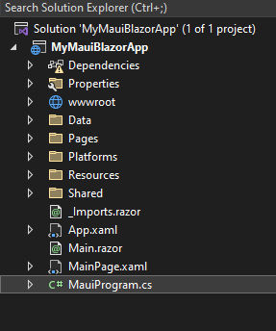
Anatomy of a MAUI Blazor App
Carl Sargunar
Platforms : Platform specific code, resources, configuration and startup logic
MauiProgram.cs : “App” bootstrapper, Set up Dependencies, Register services. Called by platform code
Resources : Fonts, Icons, Translations and assets - shared across all platforms
wwwroot : Css, Js, Web fonts etc
App.Xaml, AppShell.xaml : Same job as with a Maui App
MainPage.xaml : The first page of the application -> Main.razor
@carlcod_es
Notes:
MauiProgram called by the platform code. Similar to the Program.cs

Slide 11
.Net MAUI Blazor
Carl Sargunar
Extension of Blazor
Build for the same platforms
Use Existing Razor Class Libraries
Have Full Platform Access for each platform
Implemented through a BlazorWebView which loads a razor file
Everything runs locally in the application - unless you explicitly call external APIs etc
You can mix and match - Traditional Maui + Maui Blazor
ContentPage
Blazor WebView
Razor File
@carlcod_es
Notes:
In a Content Page, you can ONLY have ONE control
Layout control allows you to have nested control
Layouts can be themselves nested under other layouts

Slide 12
Data binding and MVVM
Carl Sargunar
Command Events
Data
Model
ViewModel
View
NotifyPropertyChanged
Data Objects, Business logic
Intermediary between the View and the Model. Presentation logic and commands.
User Interface and Layout
@carlcod_es
Notes:
In MVC, the controller handles the user input (form Post Data, Routing), but in MVVM the Viewmodel updates the data model directly based on interaction with the view.
View : How to display the UI
ViewModel : Control the flow of interaction between the Model and View.
Model: Creates the Viewmodel, contains the business logic, calls services etc.
Data Binding between Viewmodel and View is 2 way, Command binding from the view to the viewmodel
Detail : https://youtu.be/DuNLR_NJv8U?t=3700
Anytime something changes in the model, the view is informed, so any bindings are updated.

Slide 13
How does that compare to MVC
Carl Sargunar
Model
View
Controller
@carlcod_es
Notes:
MVC is Stateless
Model updates View
View posts User Input to Controller
Controller manipulates Model

Slide 14
Options for APIs
Carl Sargunar
What are we trying to do?
Consuming content from a central store
Abstraction of content storage - separation of concerns
Add new features - CRUD
Things to Consider :
Ease of integration - the development cost
Flexibility - having to maintain multiple parts of the system
Performance
Bandwidth utilization
@carlcod_es

Slide 15
Options available to us in the Umbraco Community
Carl Sargunar
Umbraco Content Delivery API - Generic REST
Cloud or Self Hosted
Restful, but verbose
Roll Your Own - Custom Rest
Full control of API + Client
More to maintain + Secure
Heartcore - GraphQL
GraphQL supported out of the box
Designed as a Managed Cloud Content Store
Roll your own - there’s a nuget package
@carlcod_es
Notes:
There is also a package

Slide 16
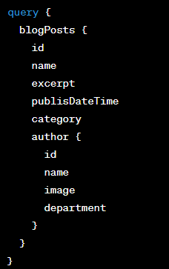
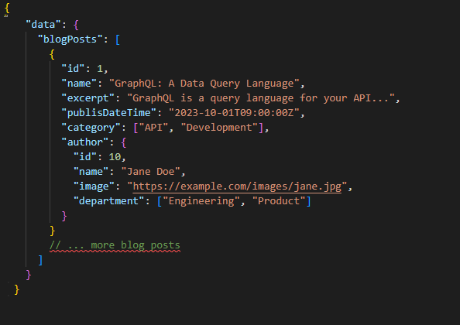
GraphQL Sample
Carl Sargunar
Request
Response
@carlcod_es

Slide 17

Demo
Carl Sargunar
Content
Store
Website
Mobile App
@carlcod_es
Notes:
Umbraco Website

Slide 18

Demo Time!
Carl Sargunar
@carlcod_es
Notes:
Detail : https://youtu.be/DuNLR_NJv8U?t=3700
Explain how this works,
Then how to use CommunityToolkit.MVVM. Source Generators
Binding can be One way (eg Labels, which change when the viewmodel changes)
Or Two way (change in ViewModel Or View)

Slide 19
GraphQL vs REST - Data Fetching
Carl Sargunar
GraphQL
Generic REST
Custom REST
Specific data fetched in a single request.
All requests hit single endpoint
Highly flexible - queries request only what they need.
Steeper learning Curve due to unique syntax and concepts
Fetch all data in a resource. Can lead to Over-fetching or Under-fetching
Single Endpoint, but post processing required
Limited Flexibility - API is defined up front. Limited expandability with Expand Property
Simpler for beginners - well understood concepts
Specific data fetched in a single request, but not as flexible as GraphQL
Multiple endpoints for different resources
Similar learning curve to REST
Flexible, but more development and
@carlcod_es
Notes:
Content Delivery API can expand some properties - with the Expand Parameter

Slide 20
Over-Fetching and Under-Fetching
Carl Sargunar
GraphQL
Generic REST
Custom REST
Client
Client
Client
Blog Post, Author
Blog Post, Author
Blog Post
Author
@carlcod_es
Notes:
Overfetching - common with REST, pulling more fields than needed
GraphQL - Query exactly what you want, but harder to implement
Custom REST - Pull exactly what you need, but a greater development cost

Slide 21
Conclusions - Best way to get content from an API?
Carl Sargunar
Content Delivery API (Generic REST) is very quick to integrate
Likely for Over-fetching - generic data structure for all data
Also Under-fetching - multiple requests likely as API is a simple gateway to content
Use Content Expansion to fetch one level of related content
Best if you don’t want to implement your own API
Custom APIs will reduce under-fetching and over-fetching
Greater development effort required - maintain API + Client
Best if you control both API and Client
No over or under fetching, just get what you need
GraphQL is an option (Heartcore or Nuget Package)
Client Integration takes more effort than REST
Large and complex queries not performant
Most Flexible - Best if you don’t know what the client needs
@carlcod_es
Notes:
There is also a package

Slide 22


Thank You!
❤️🙂🙏🤘🎸
Carl Sargunar
@CarlCod_es
https://carlcod.es
Github.com/carlsargunar
Code + Slides

